Slide 1
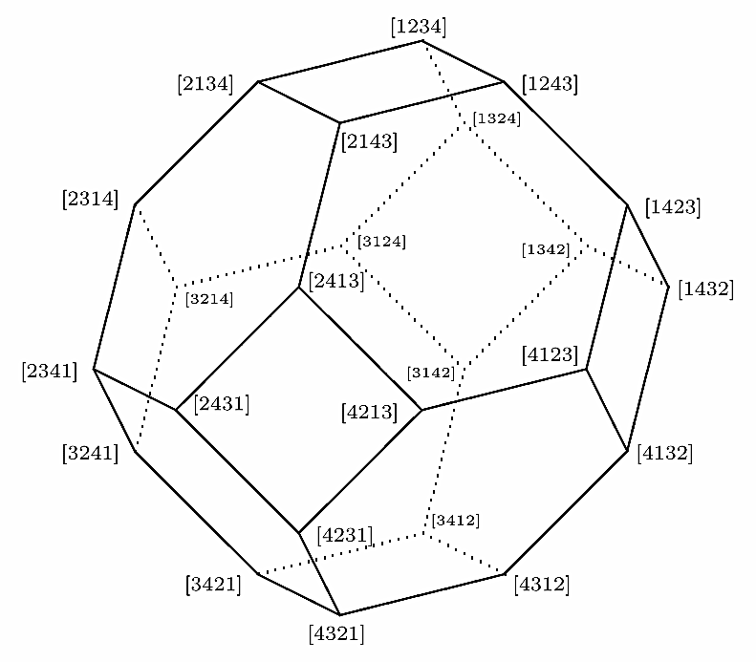
Neutrality of Mean Proximity Voting Rules
Sébastien Lahaie, Microsoft Research NYC
Nisarg Shah, Carnegie Mellon University
Notes:
Just to give a heads-up of the kind of geometry that we will dive into within the next one hour

Slide 2
Social Choice Theory
“Given a set of preferences, find a consensus”
Preferences and consensus could be from any set
Usually, preferences are rankings
Consensus can be a ranking or an alternative
Problem: No unique “consensus” among rankings
Wide array of voting rules studied in the literature
Every rule tries to justify its “aggregation of preferences into consensus” differently (axioms, MLE estimates, …)

Slide 3
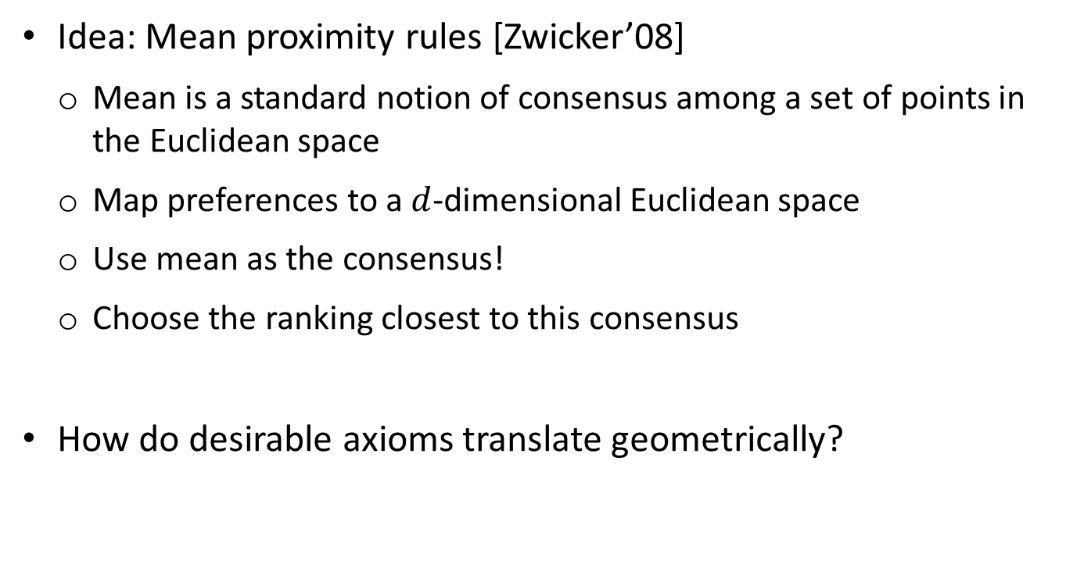
Social Choice Theory
Idea: Mean proximity rules [Zwicker’08]
Mean is a standard notion of consensus among a set of points in the Euclidean space
Map preferences to a $d$-dimensional Euclidean space
Use mean as the consensus!
Choose the ranking closest to this consensus
How do desirable axioms translate geometrically?
WS Zwicker, Consistency without neutrality in voting rules: When is a vote an average?, MaCM, 2008.
WS Zwicker, A characterization of the rational mean neat voting rules, MaCM, 2008.

Slide 4
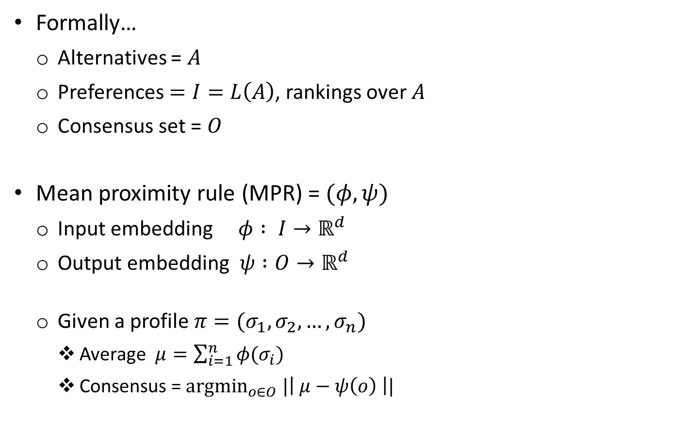
Mean Proximity Rules
Formally…
Alternatives = $A$
Preferences $=I=L\left(A\right)$, rankings over $A$
Consensus set = $O$
Mean proximity rule (MPR) = $(φ, ψ)$
Input embedding $φ : I→ℝ^{d}$
Output embedding $ψ :O→ℝ^{d}$
Given a profile $π=(σ_{1},σ_{2},…, σ_{n})$
Average $μ=\sum_{i=1}^{n}{φ(σ_{i})}$
Consensus = ${argmin}_{o∈O} |\left| μ−ψ\left(o\right) \right||$
Notes:
Explain why input and output embeddings may be different in general.

Slide 5
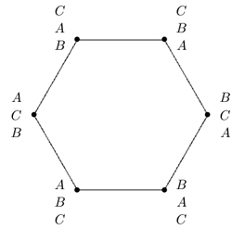
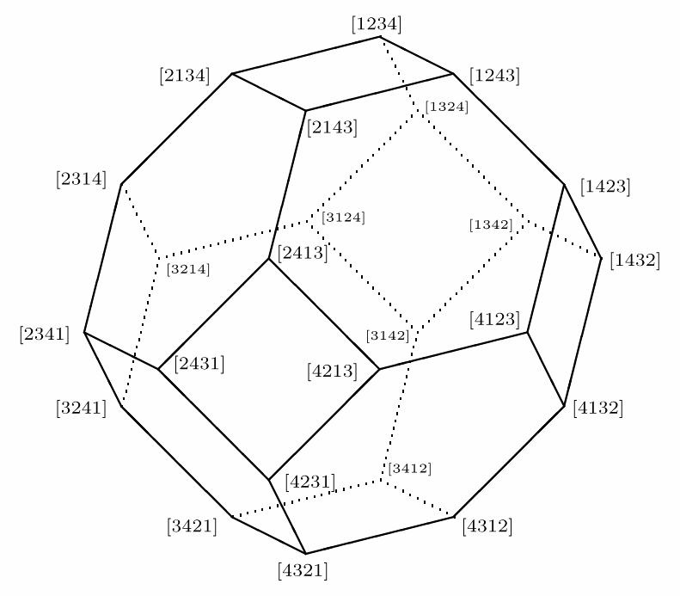

Example: Positional Scoring Rules
Plurality, Borda (shown below), $k$-approval, veto, …
Borda for 3 alternatives
Borda for 4 alternatives

Slide 6
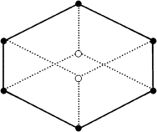



Example: Kemeny Rule
Kendall metric is number of pairwise disagreements.
Kemeny rule selects ranking that minimizes total distance (Kendall metric) to profile.
Embedding maps ranking to ${\left\{−1,+1\right\}}^{\left(\begin{matrix}m \\ 2\end{matrix}\right)}$
$$(+1,−1,+1)$$
Kemeny embedding
for 3 alternatives
$$(+1,−1,−1)$$

Slide 7
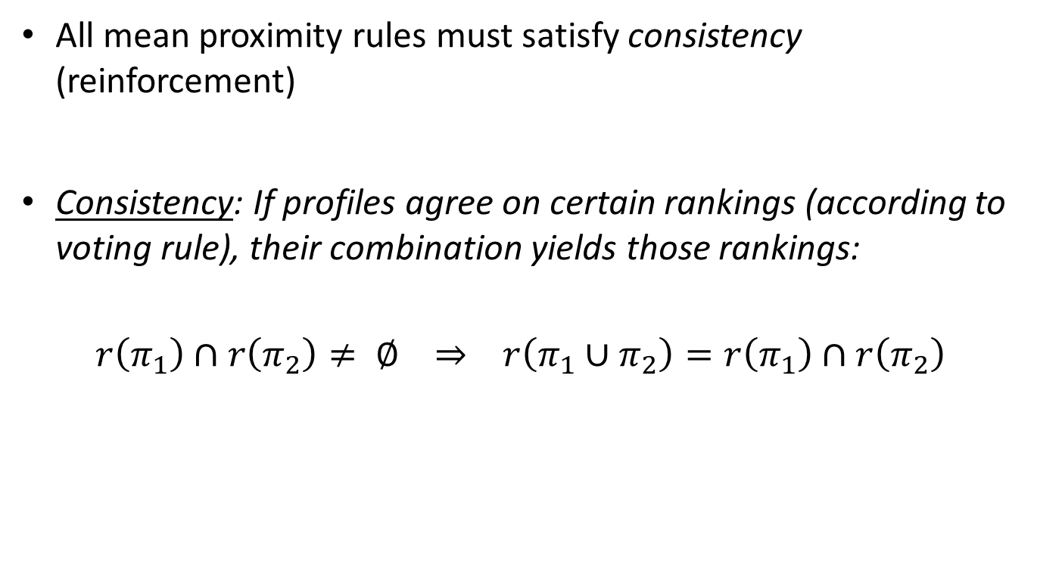
Consistency of MPR
All mean proximity rules must satisfy consistency (reinforcement)
Consistency: If profiles agree on certain rankings (according to voting rule), their combination yields those rankings:
$$r\left(π_{1}\right)∩r\left(π_{2}\right)≠ ∅ ⇒ r\left(π_{1}∪π_{2}\right)=r\left(π_{1}\right)∩r\left(π_{2}\right)$$
Notes:
Among all well-known rules, only positional scoring rules and Kemeny’s rule satisfy consistency.

Slide 8
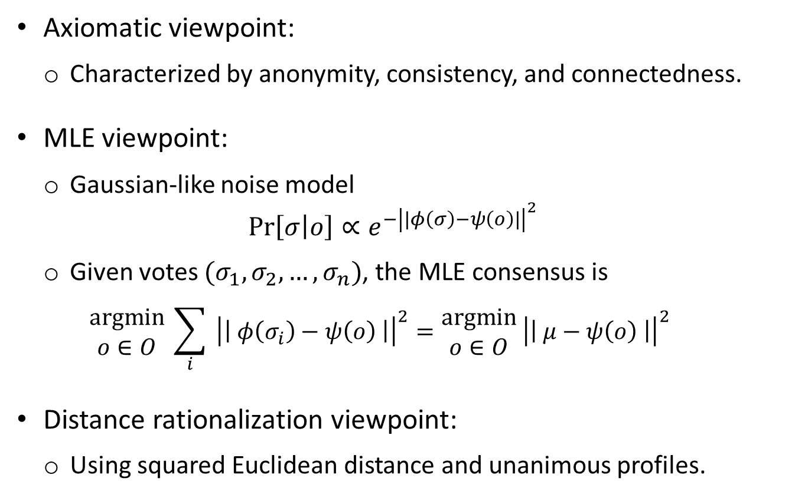
Motivations for MPR
Axiomatic viewpoint:
Characterized by anonymity, consistency, and connectedness.
MLE viewpoint:
Gaussian-like noise model $Pr\left[σ | o\right]∝e^{−{\left|\left|φ\left(σ\right)−ψ\left(o\right)\right|\right|}^{2}}$
Given votes $(σ_{1},σ_{2},…, σ_{n})$, the MLE consensus is $\begin{matrix}argmin \\ o∈O\end{matrix} \sum_{i}{ {\left|\left| φ\left(σ_{i}\right)−ψ\left(o\right) \right|\right|}^{2}}=\begin{matrix}argmin \\ o∈O\end{matrix} {\left|\left| μ−ψ\left(o\right) \right|\right|}^{2}$
Distance rationalization viewpoint:
Using squared Euclidean distance and unanimous profiles.

Slide 9





Our Contribution (1)
Investigate an important property named “neutrality” in MPRs
Intuitively means that names of the alternatives do not matter
Provide a constructive characterization of all neutral MPRs
Explicitly find all neutral MPR in dimensions 1 and 2
$$a→b$$
$$b→c$$
$$c→a$$
$$a≻b≻c$$
$$b≻c≻a$$
$$a≻c≻b$$
$$b≻c≻a$$
$$c≻a≻b$$
$$b≻a≻c$$
After relabeling
Output = $a≻b≻c$
Output = $b≻c≻a$

Slide 10
Our Contribution (2)
Unique representation theorem
All embeddings representing the same mean proximity rule are equivalent up to translation, rotation, scaling, dimension-lifting
Allows computing the minimum dimension required to represent any given mean proximity rule
We compute the minimum dimensions for PSRs and the Kemeny rule
Notes:
* Work in progress

Slide 11
Outline
Two equivalent formulations of MPR [Zwicker’08]
Symmetric mean proximity rules
Characterization in both formulations
Neutral symmetric mean proximity rules
Characterization in both formulations
Constructive characterization using group-theoretic ideas
Unique representation theorem and corollaries
Next steps
Notes:
Next steps in particular include computational consequences.

Slide 12
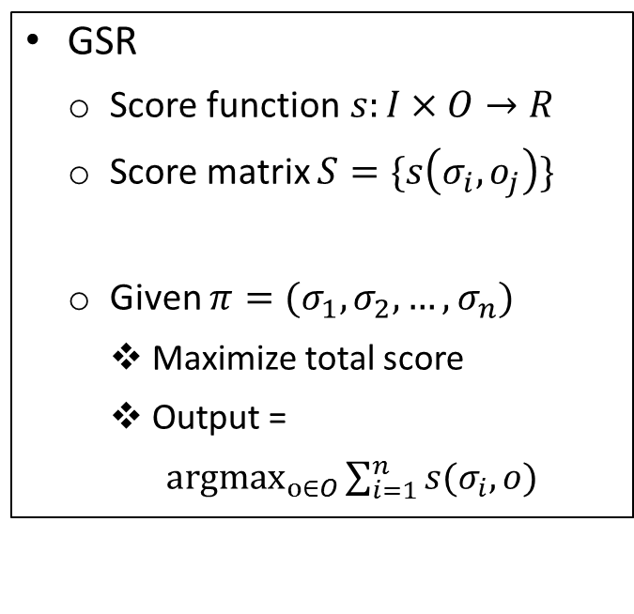
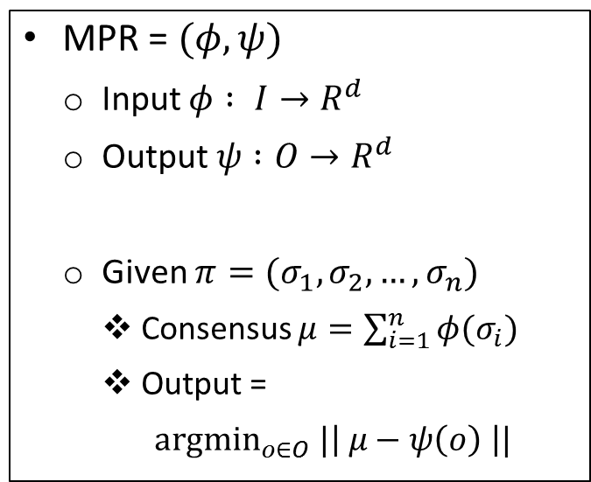
Generalized Scoring Rules
MPR = $(φ, ψ)$
Input $φ : I→R^{d}$
Output $ψ :O→R^{d}$
Given $π=(σ_{1},σ_{2},…, σ_{n})$
Consensus $μ=\sum_{i=1}^{n}{φ(σ_{i})}$
Output =
${argmin}_{o∈O} |\left| μ−ψ\left(o\right) \right||$
GSR
Score function$s:I×O→R$
Score matrix $S=\{s\left(σ_{i},o_{j}\right)\}$
Given $π=(σ_{1},σ_{2},…, σ_{n})$
Maximize total score
Output =
${argmax}_{o∈O}\sum_{i=1}^{n}{s(σ_{i},o)}$
[Zwicker’08] : A voting rule is a mean proximity rule if and only if it is a generalized scoring rule.

Slide 13
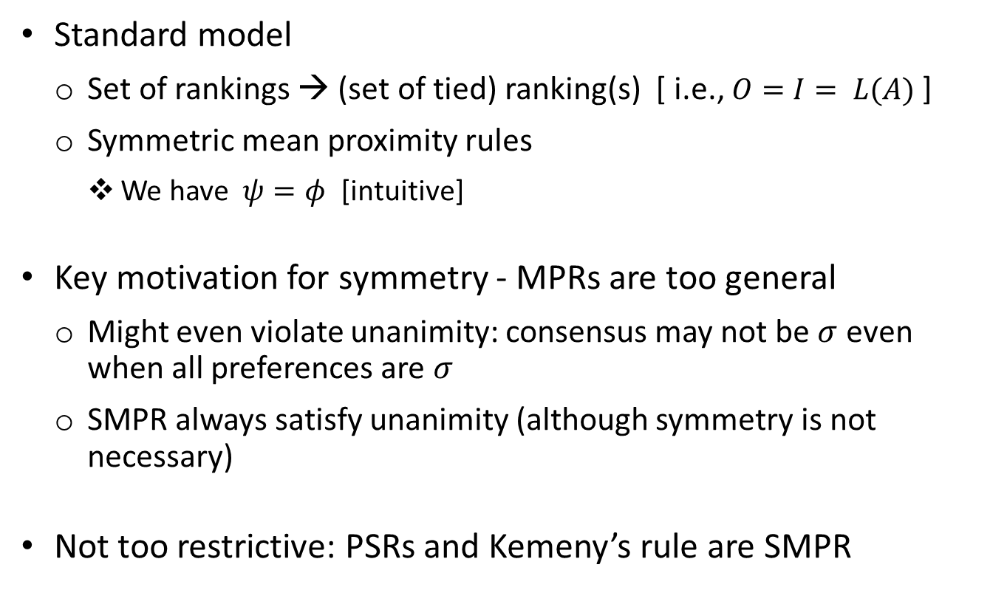
Symmetric MPR
Standard model
Set of rankings → (set of tied) ranking(s) [ i.e., $O=I= L(A)$ ]
Symmetric mean proximity rules
We have $ψ=φ$ [intuitive]
Key motivation for symmetry - MPRs are too general
Might even violate unanimity: consensus may not be $σ$ even when all preferences are $σ$
SMPR always satisfy unanimity (although symmetry is not necessary)
Not too restrictive: PSRs and Kemeny’s rule are SMPR
Notes:
Make clear the fact that unanimity is key motivator for symmetry.
However, unanimity does not imply symmetry.

Slide 14
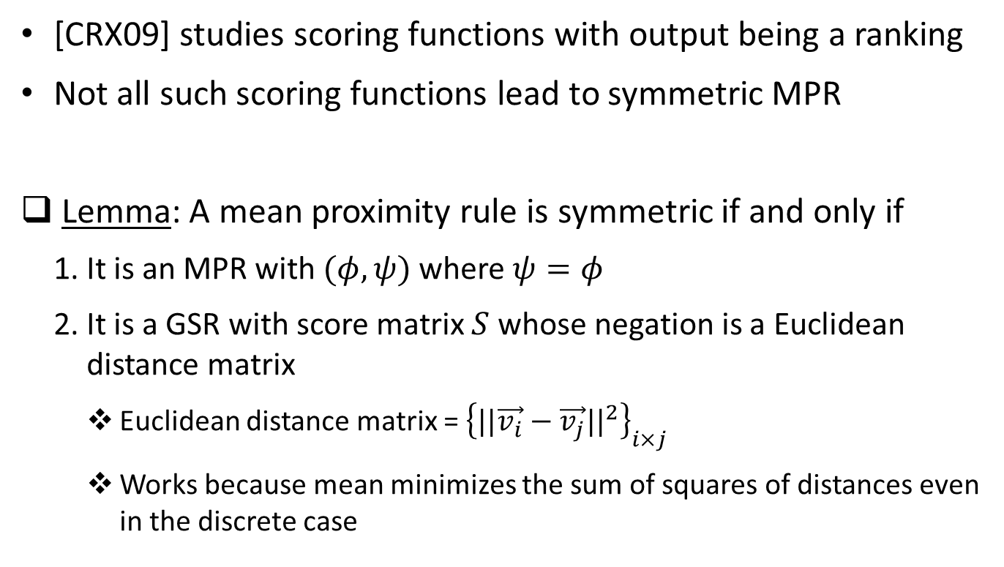
Symmetry in MPR and GSR
[CRX09] studies scoring functions with output being a ranking
Not all such scoring functions lead to symmetric MPR
Lemma: A mean proximity rule is symmetric if and only if
It is an MPR with $(φ,ψ)$ where $ψ=φ$
It is a GSR with score matrix $S$ whose negation is a Euclidean distance matrix
Euclidean distance matrix = ${\left\{{||\vec{v_{i}}−\vec{v_{j}}||}^{2}\right\}}_{i×j}$
Works because mean minimizes the sum of squares of distances even in the discrete case

Slide 15
Neutrality
Symmetry not enough
Not a desiderata from the preference aggregation point of view
Neutrality: Names of the alternatives should not matter, i.e., relabeling the alternatives in all the votes should relabel the output accordingly.
Not too restrictive --- all voting rules of interest are neutral!
Typically assumed in other viewpoints, like MLE models with “right-invariant” distance functions.

Slide 16
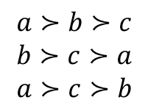
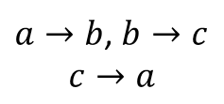

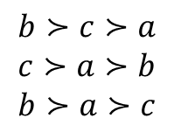

Neutrality
$$a≻b≻c$$
$$b≻c≻a$$
$$a≻c≻b$$
$a→b$, $b→c$
$$c→a$$
$$b≻c≻a$$
$$c≻a≻b$$
$$b≻a≻c$$
$$a≻b≻c$$
$$b≻c≻a$$
Consequence of neutrality :
On a profile where every ranking appears exactly once output must be the set of all rankings
Generalizes to profiles containing all permutations of a subset of alternatives (rest being fixed) starting from any ranking
We use this in our proofs …

Slide 17
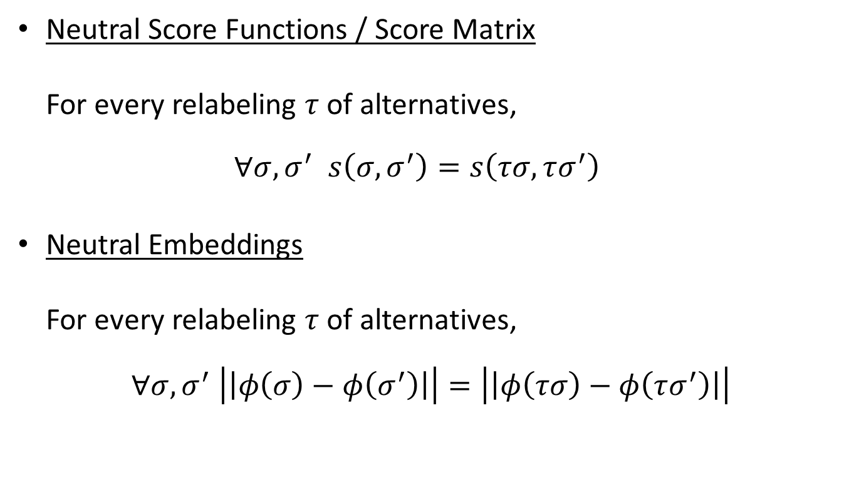
Neutral SMPR
Neutral Score Functions / Score Matrix For every relabeling $τ$ of alternatives, $∀σ,σ^{′} s\left(σ,σ^{′}\right)=s\left(τσ,τσ^{′}\right)$
Neutral Embeddings For every relabeling $τ$ of alternatives,
$$∀σ,σ^{′} \left|\left|φ\left(σ\right)−φ\left(σ^{′}\right)\right|\right|=\left|\left|φ\left(τσ\right)−φ\left(τσ^{′}\right)\right|\right|$$

Slide 18
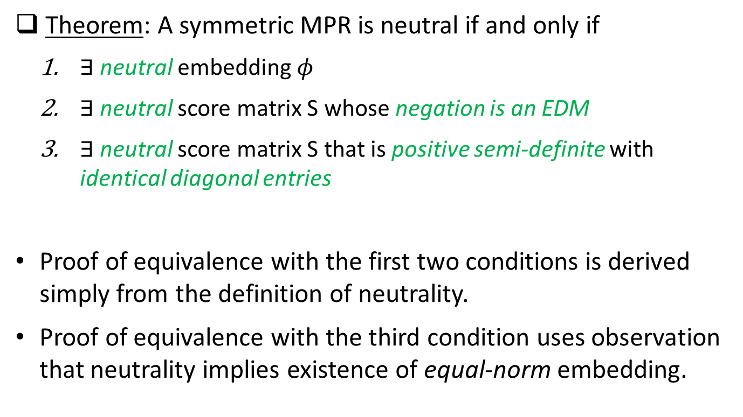
Neutral SMPR
Theorem: A symmetric MPR is neutral if and only if
$∃$ neutral embedding $φ$
$∃$ neutral score matrix S whose negation is an EDM
$∃$ neutral score matrix S that is positive semi-definite with identical diagonal entries
Proof of equivalence with the first two conditions is derived simply from the definition of neutrality.
Proof of equivalence with the third condition uses observation that neutrality implies existence of equal-norm embedding.

Slide 19
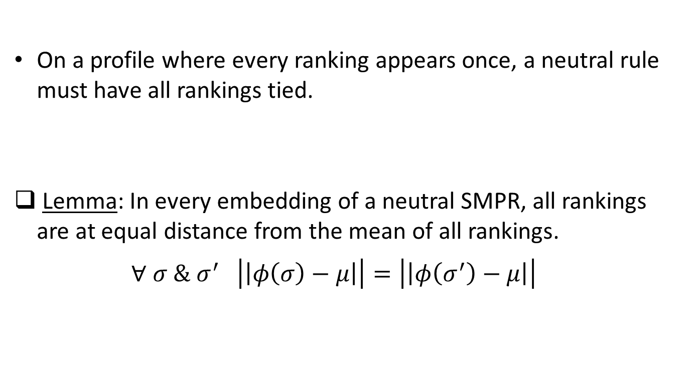
Special Embeddings of a Neutral SMPR
On a profile where every ranking appears once, a neutral rule must have all rankings tied.
Lemma: In every embedding of a neutral SMPR, all rankings are at equal distance from the mean of all rankings. $∀ σ \& σ^{′} \left|\left|φ\left(σ\right)−μ\right|\right|=\left|\left|φ\left(σ^{′}\right)−μ\right|\right|$

Slide 20
Special Embeddings of a Neutral SMPR
Lemma: Neutrality is preserved in translation, rotation, scaling, and dimension-lifting.
Scaling
Translation
Rotation
Dimension Lifting

Slide 21
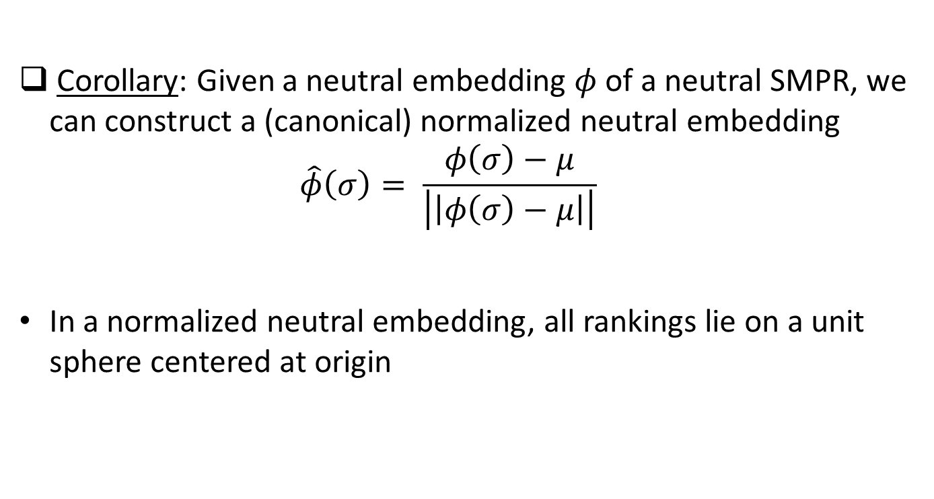
Special Embeddings of a Neutral SMPR
Corollary: Given a neutral embedding $φ$ of a neutral SMPR, we can construct a (canonical) normalized neutral embedding $\hat{φ}\left(σ\right)= \frac{φ\left(σ\right)−μ}{\left|\left|φ\left(σ\right)−μ\right|\right|}$
In a normalized neutral embedding, all rankings lie on a unit sphere centered at origin

Slide 22
Problem with Neutral Embeddings
Neutrality of an embedding can be checked, but hard to construct neutral embeddings
Difficult to “encode” information about various alternatives in the coordinates of the points in a neutral way
We give a constructive characterization
Draw ideas from group representation theory

Slide 23
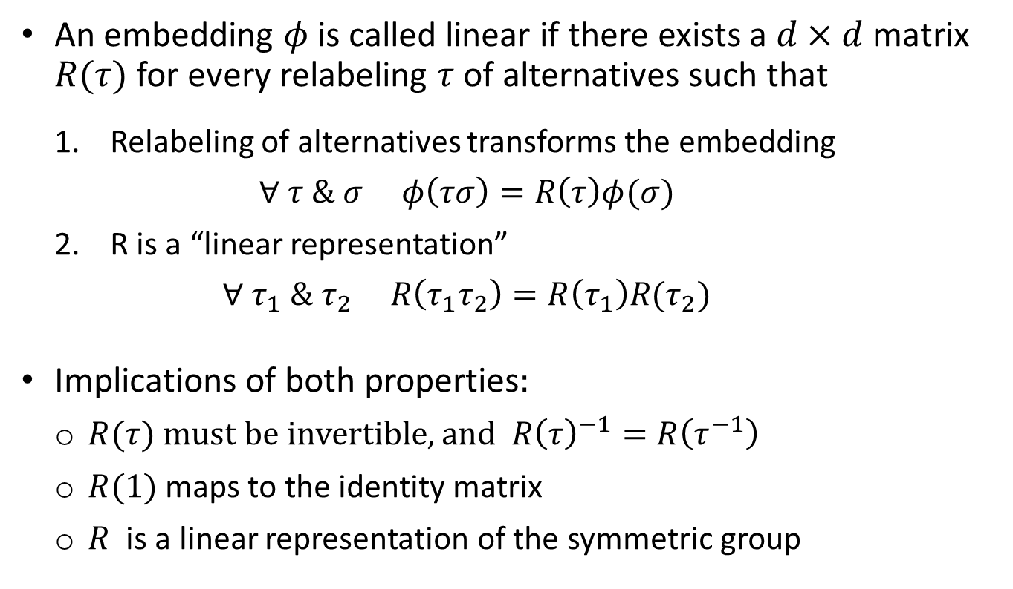
Linear Embeddings
An embedding $φ$ is called linear if there exists a $d×d$ matrix $R(τ)$ for every relabeling $τ$ of alternatives such that
Relabeling of alternatives transforms the embedding $∀ τ \& σ φ\left(τσ\right)=R\left(τ\right)φ(σ)$
R is a “linear representation” $∀{ τ}_{1} \& τ_{2} R\left(τ_{1}τ_{2}\right)=R\left(τ_{1}\right)R(τ_{2})$
Implications of both properties:
$R(τ)$ must be invertible, and $R{\left(τ\right)}^{−1}=R\left(τ^{−1}\right)$
$R(1)$ maps to the identity matrix
$R$ is a linear representation of the symmetric group

Slide 24
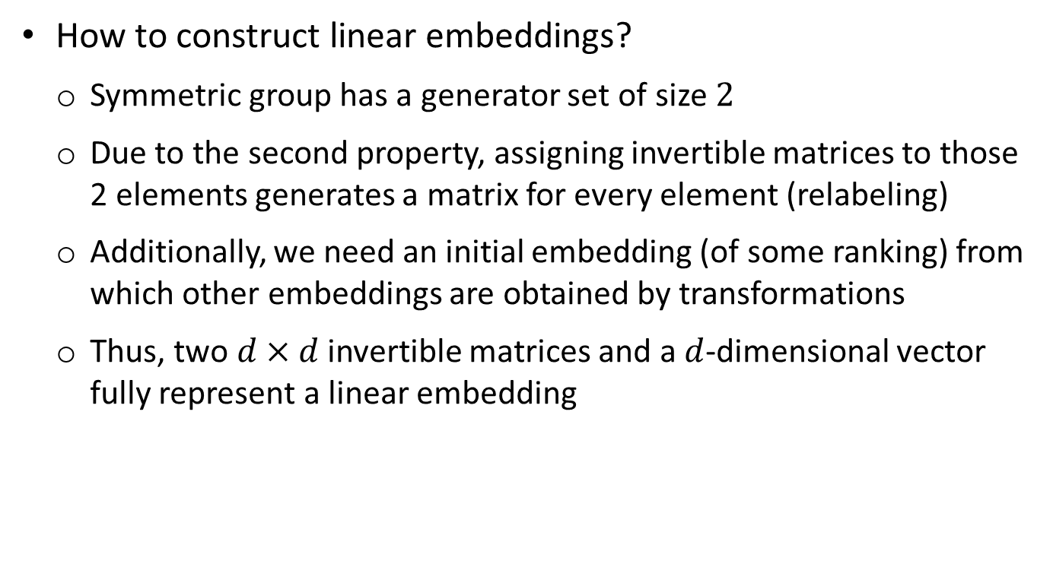
Linear Embeddings
How to construct linear embeddings?
Symmetric group has a generator set of size $2$
Due to the second property, assigning invertible matrices to those 2 elements generates a matrix for every element (relabeling)
Additionally, we need an initial embedding (of some ranking) from which other embeddings are obtained by transformations
Thus, two $d×d$ invertible matrices and a $d$-dimensional vector fully represent a linear embedding

Slide 25
Characterization: Neutrality ↔ Linearity
Theorem: An embedding is neutral if and only if its normalization is linear.
Algebraic proof, involves pseudoinverses of matrices
Given a neutral embedding, it allows explicitly finding the matrices involved in its linear representation
Proof Sketch:
Easy: Every linear embedding is neutral. Follows from definition.
Hard: Normalization of every neutral embedding is linear.

Slide 26
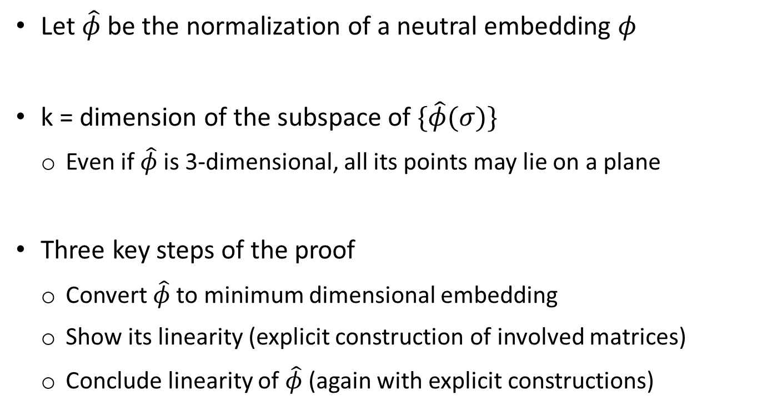
Neutrality => Linearity
Let $\hat{φ}$ be the normalization of a neutral embedding $φ$
k = dimension of the subspace of $\{\hat{φ}(σ)\}$
Even if $\hat{φ}$ is 3-dimensional, all its points may lie on a plane
Three key steps of the proof
Convert $\hat{φ}$ to minimum dimensional embedding
Show its linearity (explicit construction of involved matrices)
Conclude linearity of $\hat{φ}$ (again with explicit constructions)

Slide 27
Neutrality => Linearity
Convert $\hat{φ}$ to an equivalent k-dimensional embedding ${\hat{φ}}^{f}$
Requires translation, rotation, scaling, …
Key property is that this does not change relative distances
Hence, represents the same voting rule
Essentially, we are doing change of basis
Hexagon in 3D ($\hat{φ}$)
===>
Hexagon in 2D (${\hat{φ}}^{f}$)

Slide 28
Neutrality => Linearity
Write the set of equations
$$[{\hat{φ}}^{f}\left(τσ_{1}\right),…,{\hat{φ}}^{f}\left(τσ_{m!}\right)]=R\left(τ\right)[{\hat{φ}}^{f}\left(σ_{1}\right),…,{\hat{φ}}^{f}\left(σ_{m!}\right)]$$
For each $τ$…
LHS matrix (A) & RHS matrix (B) column-permutations of each other
Both full row-rank matrices due to the “minimum dimension” of ${\hat{φ}}^{f}$
Proof of existence of $R\left(τ\right)$ via pseudoinverses
Requires $A^{T}A=B^{T}B$
Interestingly, this exactly translates to neutrality of ${\hat{φ}}^{f}$!
Can also prove $R\left(τ_{1}τ_{2}\right)=R\left(τ_{1}\right)R\left(τ_{2}\right)$

Slide 29
Neutrality => Linearity
Once we have all the $R\left(τ\right)$ for ${\hat{φ}}^{f}$…
Do change of basis back to that of $\hat{φ}$
During this process, we can explicitly find the matrices $R\left(τ\right)$ for $\hat{φ}$given those for ${\hat{φ}}^{f}$
A final step involves proving that $R\left(τ_{1}τ_{2}\right)=R\left(τ_{1}\right)R\left(τ_{2}\right)$ holds for the matrices of $\hat{φ}$too
Corollary: A symmetric MPR is neutral if and only if it has a linear embedding.

Slide 30
Unique Representation Theorem*
Theorem: Any two embeddings of a neutral SMPR are equivalent up to translation, rotation, scaling, and dimension-lifting.
Key step is Cauchy’s rigidity theorem
Cauchy’s rigidity theorem: Any two convex polytopes with identical “combinatorial geometry” and equal side lengths are congruent to each other.
Combinatorial geometry is hierarchy of inclusion of smaller dimensional faces to larger dimensional faces (vertices → edges → faces → …)
* Work in progress. May be generalized to non-neutral SMPR.

Slide 31
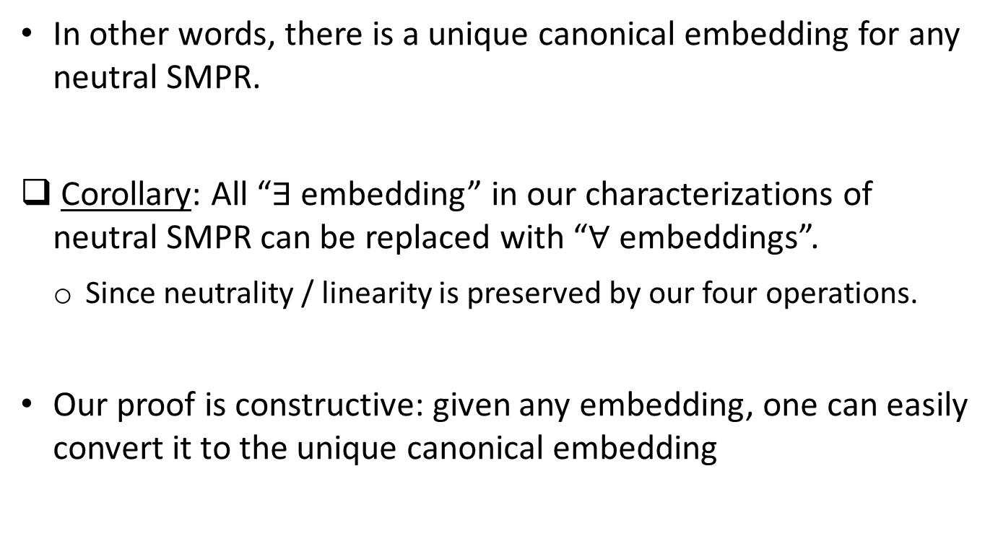
Unique Representation Theorem*
In other words, there is a unique canonical embedding for any neutral SMPR.
Corollary: All “$∃$ embedding” in our characterizations of neutral SMPR can be replaced with “$∀$ embeddings”.
Since neutrality / linearity is preserved by our four operations.
Our proof is constructive: given any embedding, one can easily convert it to the unique canonical embedding

Slide 32
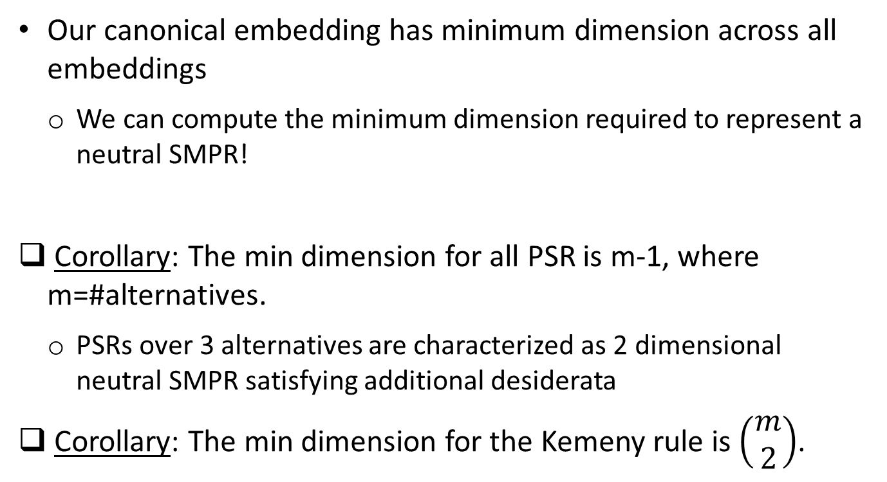
Implications of the Theorem
Our canonical embedding has minimum dimension across all embeddings
We can compute the minimum dimension required to represent a neutral SMPR!
Corollary: The min dimension for all PSR is m-1, where m=#alternatives.
PSRs over 3 alternatives are characterized as 2 dimensional neutral SMPR satisfying additional desiderata
Corollary: The min dimension for the Kemeny rule is $\left(\begin{matrix}m \\ 2\end{matrix}\right)$.
Notes:
Additional desiderata:
a is first in all rankings => a is first in all outputs &
a is last in all rankings => a is last in all outputs

Slide 33
Future Directions
Finding the ranking whose embedding is closest to the mean is computationally expensive!
Geometrically motivated approximation algorithms
A particular alternative-by-alternative approximation of the Kemeny ranking yields Borda ranking, which is known to be a 4-approximation
Empirical evaluation of geometric heuristics
Generalization of our results from squared mean to generic Bregman divergence
The corresponding noise model is generalized to exponential family model.

